Slide 1
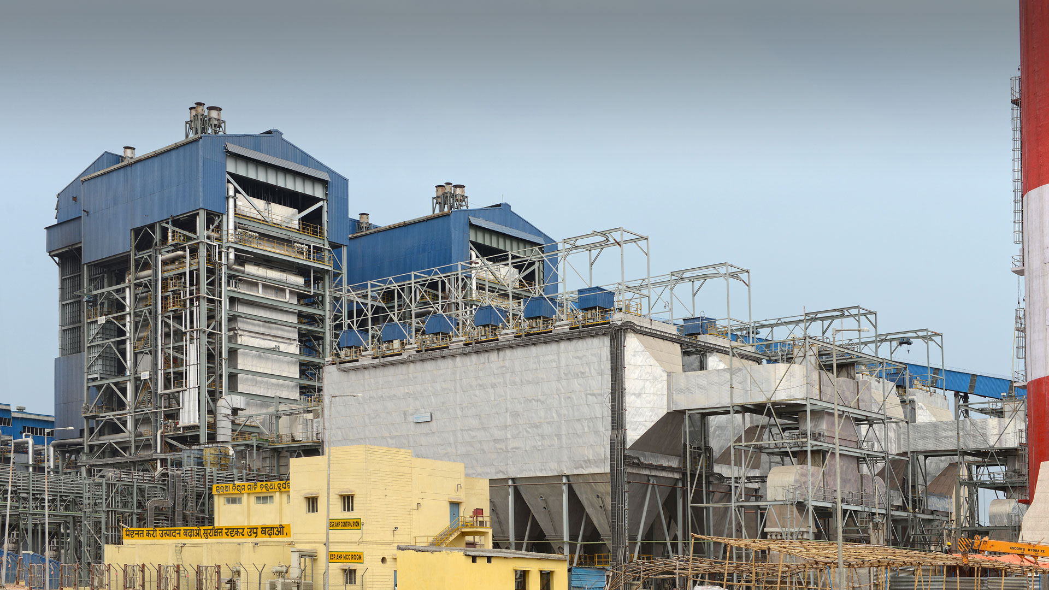
Ash Analysis report of 35 Tph slop fired boiler
By awake chaudhary

Slide 2
Connect with me
Email: awakechaudhary@gmail.com
LinkedIn: https://www.linkedin.com/in/awake-chaudhary-741006146/

Slide 3
Ash constituents and their melting points.
Constituents | Melting point(º C)
SiO2 | 1710
Al2O3 | 2072
Fe2O3 | 1565
CaO | 2572
MgO | 2852
Na2O | 1132
K2O | 740
TiO2 | 1843
P2O5 | 340
SO3 | 16.9
Cl | -101.5
Mno | 1945

Slide 4
SiO2
Around 50 to 70 % bagasse ash consist of SiO2 in its ash.
Melting point of SiO2 is 1710 degree Celsius.
Low temp deposition of SiO2 is possible (<500 degree Celsius) with chemical vapour deposition .
SiO2 is acidic in nature.
Si + O2 = SiO2
Si + 2H2O =SiO2 + 2H2
It is very rigid & hard because due to strong covalent bond b/w silica and oxygen( found in crystalline structure) .
Due to absence of free electron it is insoluble in water but soluble in hydrofluoric acid.
Metal erosion occur due to SiO2 in boiler.( erosion depends on the flue gas velocity ) .

Slide 5
SO3 & Na2O
Melting Point of SO3 – 16.9ºC.
Melting point of Na2O- 1132ºC.
Sulfur trioxide quickly react with moisture in air to form H2S04 mist.
SO3 + H20 =H2SO4
It shows negative effect on boiler such as fouling & corrosion.
It can increase opacity in the stack by forming sulfuric acid droplets and sulfate aerosols, which are fine particulate (PM 2.5 ) sources.
SO3 formed in temp range 400 to 600ºC.
To avoid corrosion the temperature should be above dew point temp SO3.
(Dew point = 20log (SO3%) + (2Xmoisture(% in flue gas) + 184) )
Example – Operating APH above dew point of SO3 . It decreases the electricity generation efficiency.
(electricity generation efficiency of the boiler is decreased by 1% when the APH outlet temperature is increased by 20 °C)

Slide 6
SO3 & Na2O
Melting Point of SO3 – 16.9ºC.
Melting point of Na2O- 1132ºC.
Sulfur trioxide quickly react with moisture in air to form H2S04 mist.
SO3 + H20 =H2SO4
It shows negative effect on boiler such as fouling & corrosion.
It can increase opacity in the stack by forming sulfuric acid droplets and sulfate aerosols, which are fine particulate (PM 2.5 ) sources.
SO3 formed in temp range 400 to 600ºC.
To avoid corrosion the temperature should be above dew point temp SO3.
(Dew point = 20log (SO3%) + (2Xmoisture(% in flue gas) + 184) )
Example – Operating APH above dew point of SO3 . It decreases the electricity generation efficiency.
(electricity generation efficiency of the boiler is decreased by 1% when the APH outlet temperature is increased by 20 °C)

Slide 7
Interference of Fly Ash on SO3 Collection
There are two kind of interaction between them
Fly ash can be an SO3 adsorbent under lower-temperature ranges
SO 3 most likely occurs as H2SO4 mist droplets and is condensed on the fly ash if the temperature is close to or below the dew point of SO3.
SO3 may react with multiple fly ash constituents, which are likely to be alkali earth metal oxides (such as CaO and MgO), alkali metal oxides (such as Na2O and K2O ).and It happens above 150ºC.
CaO + SO3 → CaSO4 (above 880ºC)
MgO + SO3 → MgSO4
Na2O + SO3 → Na2SO4( Highly corrosive when molten, generally formed at 884ºC)
SO3 + K2O → K2SO4 (formed 300ºC – 800ºC )
Corrosion at high temp
Fuels impurities form low melting point deposits which are ionic conductive and are able to transfer the electrons.
Sulphur also is oxidized to SO2 and SO3 depending on the temperature and amount of oxygen content in the boiler.
2SO2 + O2 = 2SO3 ( high excess oxygen).
In initial stages, an oxide film forms on the tube surface. Sodium sulphate then deposits on the oxide layer. Afterward, the outer surface of Na2SO4 layer begins to become sticky and absorb fly ash particles.

Slide 8
Chlorine
Spent wash consist of high amount of chlorine.
Chlorine is the main constituent found on the corroded area.
Melting point of chlorine is -101°C.
Chlorine is converted mostly to HCL during combustion.
Moist chlorine, primarily because of the hydrochloric and hypochlorous acids(HClO) formed through hydrolysis, is very corrosive to steel alloys.
It is believed that every 0.1 % Cl in coal produces 80 ppm of HCl in flue gas.
That HCl reacts with the alkali metals Na and K to form NaCl and KCl, which have a low melting point. If these compounds are present in the slag, they can form a molten corrosive layer on the boiler tubes.
sulfur is also present in the flue gas, SO3 replaces the chlorine and sulfate deposits form. Sulfate deposits have higher melting points than chlorides and are less corrosive.

Slide 9
Oxides in combustion
Acid oxides are SiO2,Al2O3 and TiO2.
Basic oxides are Fe2O3,CaO,MgO,Na2O,K2O.
Base and acid oxides is formed during combustion and their ratio is used to determine the fusion (fusibility) temperature temperature of reaction product.
Ash exhibit low fusibility temperature with higher slagging potential when its base/acid ratio is in range 0.4 to 0.7.
The fusibility temperature of ash will be lowered when Fe2O3/CaO ratio is in range of 0.2 to 1.

Slide 10
Base to acid ratio = (Fe2O3+CaO+MgO+Na2O+K2O)/(SiO2+Al2O3 +TiO2)
=20.63/21.03
=0.98
Slagging index= (Base to acid ratio) x Dry sulfur content.
= 0.98 x 1.9
=1.862
Fouling index =(Base to acid ratio) x (Na2O +K2O)
= 0.98 x 10.31
=10.10
<0.6, low slagging inclination 0.6–2.0, medium 2.0–2.6, high >2.6, extremely high
≤0.6, low fouling indication 0.6–40, high >40, extremely high

Slide 11
Connect with me
Email: awakechaudhary@gmail.com
LinkedIn: https://www.linkedin.com/in/awake-chaudhary-741006146/
Thank you

